Slide 1
CP5634 DATA MINING DATA MINING REPORT ON CENSUS INCOME
PRESENTED BY:
VIPULDEEP SINGH GULATI
JC497971

Slide 2
Outline
Census Income Dataset description
Introduction to Weka
Data Mining Steps
Data Cleaning
Data Integration
Data Transformation
Data Selection
Data Normalization
Data Discretization
Data Classification
Comparison Table
Conclusion
Storage
Data Mining Algorithms
Processing Power

Slide 3
Census Income Dataset description
The dataset consists of data regarding the Persons attributes which lists down the information who has more income and who has less income. The aim is to determine who earns more than 50k annually. The last attribute represents the annually income as “<=50k” more than 50k or “>=50k” less than 50k.
ATTRIBUTE CHARACTERSTICS | Categorical, Integer
ASSOCIATED TASKS | Classification
NUMBER OF ATTRIBUTES | 14
NUMBER OF INSTANCES | 48842

Slide 4

Introduction to Weka
Weka is open source software which is written in java. Source code can be modified in this software. Weka is preferred because it is easy to use, it has a mouse point-and-click GUI interface and can compare algorithms quickly. Weka has a list of applications which can be used to achieve different tasks. These applications are mentioned below:
Explorer
Experimenter
Knowledge Flow
Workbench
Simple CLI

Slide 5
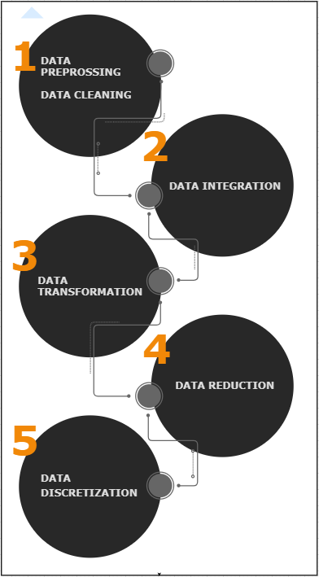
Data Mining Steps
Data Pre-processing
Data Pre-processing is important because data must be combined combined, transformed, reduced, discretized, visualized to extract maximum knowledge out of it. Data can be incomplete, noisy and inconsistent which means it can contain incomplete values, can contain errors and can contain discrepancies.

Slide 6
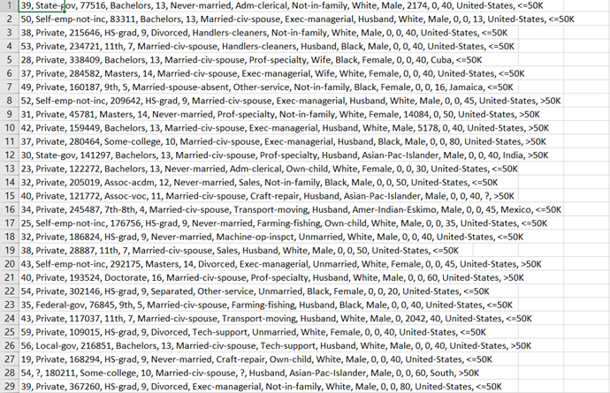

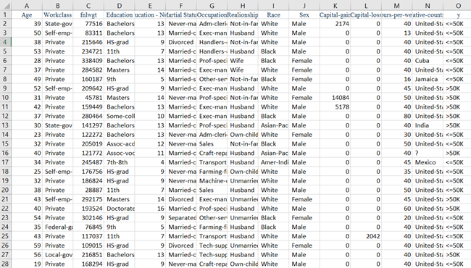
STEPS DESCRIBED BREIFLY
Data Cleaning
Data cleaning is referred to as filling up of missing values, null spaces and identifying or removing outliers in order to make it more relevant. Data cleaning and pre-processing the major task and the most difficult task out of all as it could end up consuming 60 percent of user’s time. The dataset for this report was already clean so it required no cleaning. The “?” represented unknown.
Data Integration
Data Integration combines multiple data sets of different formats into the same format before data transformation. For this assignment, only single format has been taken. So, Data Integration has been eliminated in data pre-processing.

Slide 7
Data Transformation
Data transformation which leads to normalize data into same scale. For Weka, it requires CSV file extension to run.
The Text file is opened in MS Excel and converted to a clearer format by using Text-To-Columns data tool which delimits and separates the data on the basis of comma. Then the data is thoroughly checked and save with the Weka compatible format which is .csv.
Data Selection
Data Selection is the selection of only that data which is necessary. When the Weka compatible file is run in Weka, some unnecessary data/attributes can be noticed that will not affect the whole model and is useless. This data needs to be removed before any further data pre-processing process. For Census Income Dataset, there were 15 attributes and not a single attribute was removed. This can be done by either selecting the attributes manually or by choosing filter RemoveUseless under unsupervised.

Slide 8
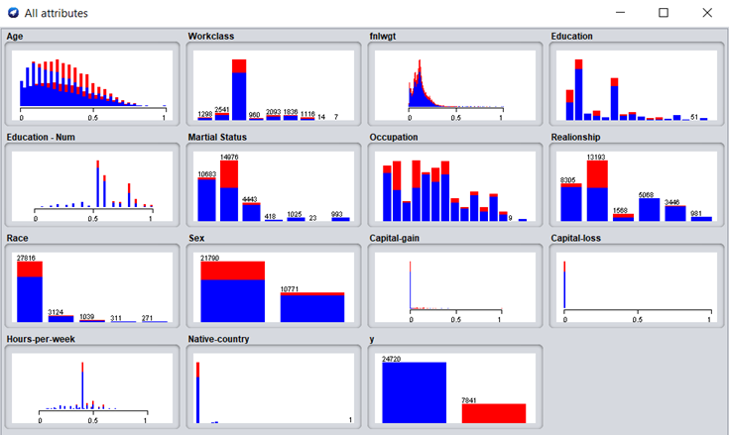

Data Normalization
Data Normalization is nothing but the process of transforming the number of variables of the data in a same range of 0 to 1. It is done in order to perform well and get better results.
Data Discretization
Data Discretization simplifies the data of the dataset. It divides the range of a continuous
attribute into intervals. Some of the classification algorithms accepts categorical attributes.

Slide 9
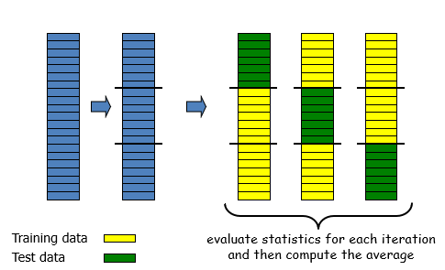
Cross VALIDATION AND PERCENTAGE SPLIT
Cross Validation
It divides the data into two halves not equal one. The training set and test data. The training set is use to train the model and test the data. Data is divided into k parts which is randomly set by the user.
Percentage Split
It is a resampling method. It leaves out random N% of the original data. This can be explained by example. If we take 30 percent of data to be formed a test data then other 60 percent will be training data. And this will go again and again

Slide 10
Sr No. | Algorithm | Folds | Time Taken to build model (sec) | Precision | TP Rate
1 | OneR | 10 | 0.09 seconds | 0.829 | 0.782
 |  | 30 | 0.01 seconds | 0.829 | 0.782
 |  | P S | 0.02 seconds | 0.831 | 0.787
2 | BayesNet | 10 | 0.17 seconds | 0.842 | 0.819
 |  | 30 | 0.04 seconds | 0.843 | 0.819
 |  | P S | 0.03 seconds | 0.849 | 0.822
3 | ZeroR | 10 | 0.01 seconds | ? | 0.759
 |  | 30 | 0.01 seconds | ? | 0.759
 |  | P S | 0.01 seconds | ? | 0.765
4 | Decision Table | 10 | 2.98 seconds | 0.826 | 0.835
 |  | 30 | 2.83 seconds | 0.826 | 0.836
 |  | P S | 0.01 seconds | 0.833 | 0.842
5 | Logistic | 10 | 18.94 seconds | 0.846 | 0.852
 |  | 30 | 20.23 seconds | 0.846 | 0.852
 |  | P S | 20.98 seconds | 0.846 | 0.852
6 | J48 | 10 | 0.43 seconds | 0.836 | 0.843
 |  | 30 | 0.19 seconds | 0.837 | 0.844
 |  | P S | 0.19 seconds | 0.841 | 0.847
7 | NaiveBayes | 10 | 0.04 seconds | 0.842 | 0.819
 |  | 30 | 0.01 seconds | 0.842 | 0.819
 |  | P S | 0.01 seconds | 0.848 | 0.822
8 | NaiveBayesUpdatable | 10 | 0.01 seconds | 0.842 | 0.819
 |  | 30 | 0.01 seconds | 0.842 | 0.819
 |  | P S | 0.04 seconds | 0.848 | 0.822
9 | Bagging | P S | 0.03 seconds | 0.834 | 0.839
10 | ADABoostM1 | P S | 0.01 seconds | 0.795 | 0.804
COMPARISION

Slide 11
CONCLUSION
After running all different types of classification algorithm, it could be clearly seen that no algorithm is perfect. Data selection should be done carefully. Ultimate goal is to remove redundancies and have an algorithm that produces fasted results and with accuracy. This is because if the algorithm ends up being not efficient then it high crash for the big test dataset. Initially, Logistic was selected as the best algorithm with precision of 84 percent and TP rate of 85 percent. Only reason to not select this algorithm is because it took approximately 19 seconds to build the model, so if a test data will be given to it; it will take a lot of time or it might crash too. Thus, NaiveBayes was selected as a good algorithm out of all the algorithms that have been tested on Census Income dataset with the precision of 84 percent, TP rate of 81 percent and taking minimum building time for the model of 0.1 seconds. The selection of best algorithm is based both on speed of how fast the model is and how précised the model is.

